Slide 1
Audio Programming
An example of a Research Kick off for building Apps

Slide 2

Understanding NATURE OF THE PROBLEM STATEMENT
What needs to be built ?
How can it be built ?
How much of it is already built ?
How can the app that we build be different and better from the ones already out there ?
How differently and efficiently can we build it ?

Slide 3
Understanding the Application
Break down your vision into features of the App. Example : Users can perform alone or with friends(live or pre-recorded by other performers).
Enhancing User Experience. Example: In Audio Engine based Apps use of Audio Filters
Decide on chronology of how and when the filters need to kick in
Create a cloud-based computing platform for Real-Time Implementation of Audio Algorithms
Feature to capture or save Results/Recordings

Slide 4
Structure of Solution
Audio pipeline from the Android client to AWS and back to Android client
1. Build a CI/CD Pipeline for your Android App with AWS Services
2. AUDIO COMPRESSION
Well-architected components for complex and ambiguous technical problems
1. Audio Engine to be used
2. Industry Audio Middleware

Slide 5

Build a CI/CD Pipeline for your Android App with AWS Services
A CodeCommit repository to store the Android app’s code.
A CodeBuild project to compile, package, and deliver the Android app.
A Device Farm project to test the Android app on real physical devices.
An S3 bucket to store build artifacts.
A CodePipeline pipeline to monitor changes to the CodeCommit repository. Then it triggers a build using CodeBuild and tests using Device Darm.
AWS Lambda functions to invoke the Device Farm test from CodePipeline, and also to provision the Device Darm project from AWS CloudFormation

Slide 6
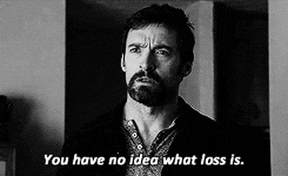
Audio Compression – Lossy or lossless
Choosing the right Compression Algorithm will help us save memory that we will be using in the cloud.
FALC :
1. FLAC : Free Lossless Audio Codec : Popular and Promising Algorithm for Lossless compression.
2. These types exploit coding rather than auditory optimizations and certainly don’t compress files to anywhere near as small
3. FLAC is Supported in Android 3.1 or later
4. Compression Ratio of FLAC : ~ 2:1

Slide 7
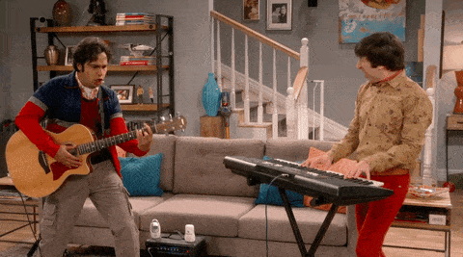
OPUS
Initially thinking of Lossless Audio being ideal for us, FLAC was a great choice. Since we are identifying our target Audience as Non-Singers/Musicians, we can compromise on this idea and rather use a lossy Algorithm and save more memory using OPUS or AAC.
OPUS :
1. Low Latency in nature
2. Supports only 48K Sampling
3. Compression ratio -> 10.5:1
4. Designed to be suitable for interactive real-time applications over the Internet, including music as well as speech
5. Opus library is free and open source, so you can write your own app for Android that will capture audio from mic, encode it with Opus codec, and send to your server

Slide 8

Advanced Audio Coding (AAC)
AAC is the most popular type of lossy compression, while Hi-Res libraries offer FLAC as standard lossy compression options out there are virtually indistinguishable from CD quality
Compression ratio of 10.9
At higher bitrates (say, higher than 80 kbps) LC is better than HE.
At lower bitrates, (lower than 80 kbps) HE is better than LC (note that at such bitrates both LC and HE are not transparent, but HE-AAC sounds better than LC-AAC)

Slide 9
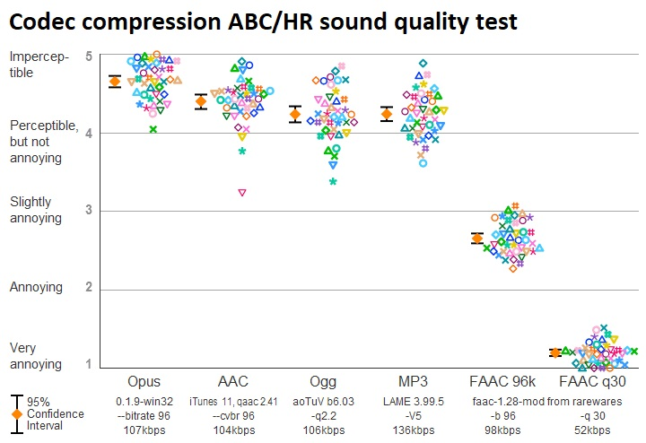
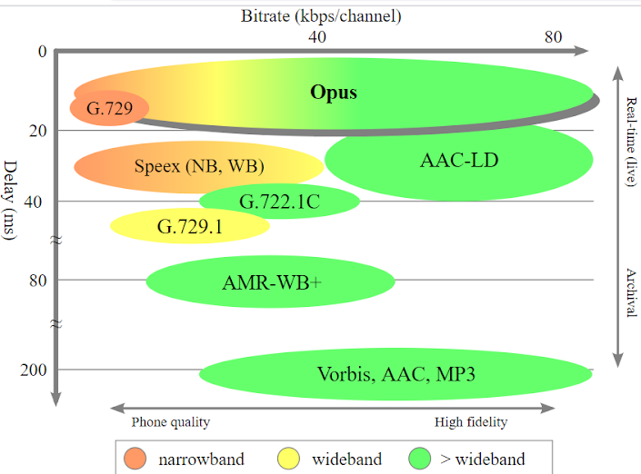
Who’s better???

Slide 10

Audio Engines
The audio engine is the component which consists of algorithms related to the loading, modifying and output of sound through the client's speaker system. At a minimum it must be able to load, decompress and play sound files. More advanced audio engines can calculate and produce such things as Doppler Effect , echoes, pitch/amplitude adjustments, oscillation etc.
Superpowered Audio Engine or Superpowered SDK :
Superpowered technology uses less than half the power of Apple’s Core Audio and is more than twice as fast as Apple’s vDSP.
Built : Noise Classification App, Adaptive Filter, Hearing Aid App (Round-Trip Audio Latency was a problem)

Slide 11
MW Engine
Its purpose is to sequence audio in a musical context : it offers strict timed playback of audio events, digital signal processing (DSP) for applying effects, real time synthesis, sample playback and recording
Audio engine and DSP for Android, written in C++ providing low latency performance in a musical context, supporting both OpenSL and Aaudio
Elder Brother to Google OBOE : MWEngine and Oboe are merely different abstraction layers to solve the same problem.

Slide 12
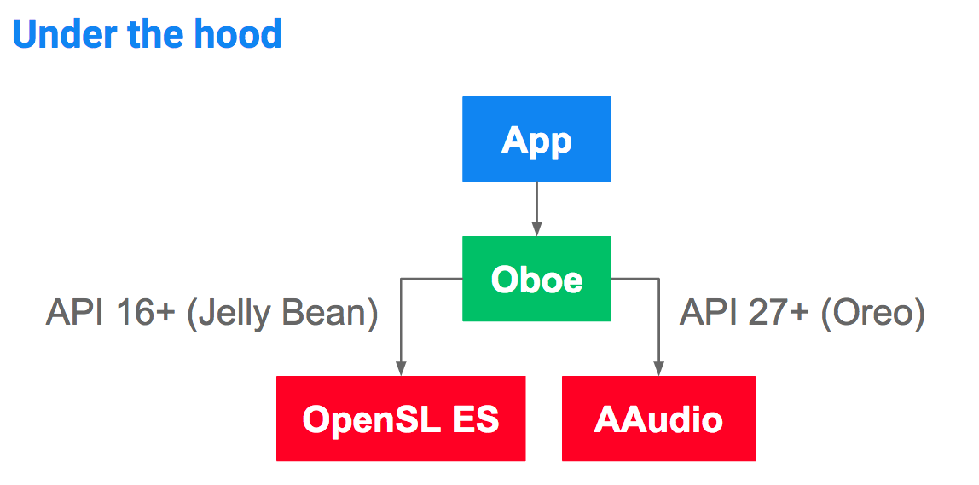
Google oboe
Oboe is a C++ library which makes it easy to build high-performance audio apps on Android. It was created primarily to allow developers to target a simplified API that works across multiple API levels back to API level 16 (Jellybean).
Oboe calls AAudio when AAudio is available, and falls back to OpenSL ES if AAudio is not available
Automatic latency tuning
Claims to have lowest possible audio –latency

Slide 13
AAUDIO
AAudio is a new Android C API introduced in the Android O release. It is designed for high-performance audio applications that require low latency. Apps communicate with AAudio by reading and writing data to streams.
Audio device enumeration
Automated routing between audio endpoints
File I/O
Decoding of compressed audio
Automatic presentation of all input/streams in a single callback.

Slide 14

Tools and Middleware
Sound Designers and Composers have FMOD, WWise and FABRIC
Tools that allow both audio and engineering teams to monitor audio statistics which assists:
optimization of audio memory and cpu usage
optimization of audio channel usage to help mix
debugging and reporting tools to help find issues quickly

Slide 15
Ideas and Questions for the Future
Compression of Video of the Basic Animations in a game
Videos and animations are subject to how the singer sings : Features available in Samsung S20 Ultra - AR Emoji is in MASK mode when first created and follows your facial expressions.
How are we planning to implement the live singing experience ?
1. Amazon Chime
2. VOIP using OPUS
Proximity effect of microphones
Modulate/filter and remix the background music files available
Amazon Polly : Dynamic Range Compression (DRC) :
You can now use the new dynamic range compression (DRC) tag to enhance the volume of certain sounds in your audio file.

